Slide 1

Mutual Fund Analytics Dashboard
Bluestock Fintech Capstone Project
Presented by: Swapnil Singh

Slide 2
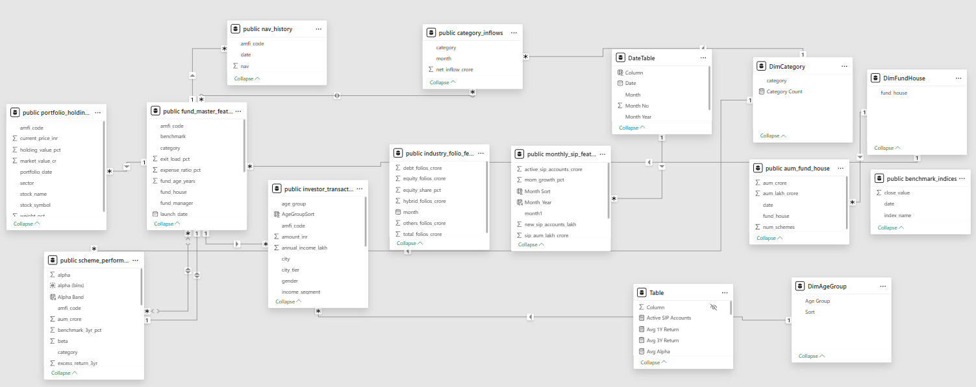
Project Overview
Developed an end-to-end Mutual Fund Analytics Dashboard using Python, PostgreSQL, and Power BI.
Cleaned and transformed raw data to generate interactive dashboards and business insights.
Analyzed fund performance, investor behavior, and SIP trends.
Objectives
Analyze mutual fund performance.
Study investor demographics.
Track SIP trends.
Build interactive dashboards.
Support data-driven decisions.
Raw Mutual Fund Datasets
↓
Python (Data Cleaning)
↓
PostgreSQL (Database)
↓
Power BI (Power Query)
↓
Data Modeling
↓
DAX Measures
↓
Interactive Dashboards
↓
Business Insights.

Slide 3







Technology Stack Python PostgreSQL Power BI Excel
Technology | Purpose
Python (Jupyter Notebook) | Data cleaning and preprocessing
Pandas & NumPy | Data manipulation and numerical analysis
PostgreSQL | Database management and data storage
Power Query | Data transformation (ETL)
Power BI | Dashboard development and visualization
DAX | KPIs, calculated measures, and dynamic analysis
Microsoft Excel | Initial data exploration and validation

Slide 4
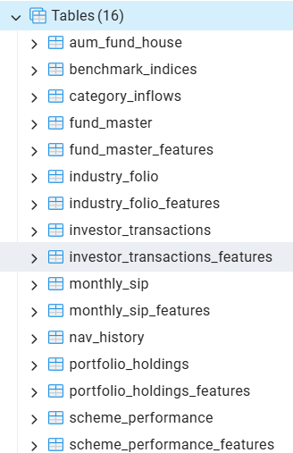
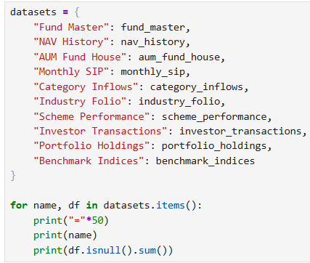


Problem Statement & Solution
Problem Statement
Mutual fund data was distributed across multiple datasets, making analysis complex and time-consuming.
Manual analysis made it difficult to compare fund performance, investor behavior, and SIP trends efficiently.
There was a need for a centralized, interactive Business Intelligence solution to support data-driven decision-making.
Solution
Cleaned and preprocessed raw datasets using Python (Pandas & NumPy).
Stored structured data in PostgreSQL.
Connected PostgreSQL to Power BI and transformed data using Power Query.
Built a relational data model and created DAX measures.
Developed four interactive dashboards to analyze mutual fund performance, investor analytics, and SIP trends.
Raw Datasets
↓
Python (Data Cleaning)
↓
PostgreSQL
↓
Power BI (Power Query)
↓
Data Modeling
↓
DAX Measures
↓
Interactive Dashboards
↓
Business Insights

Slide 5
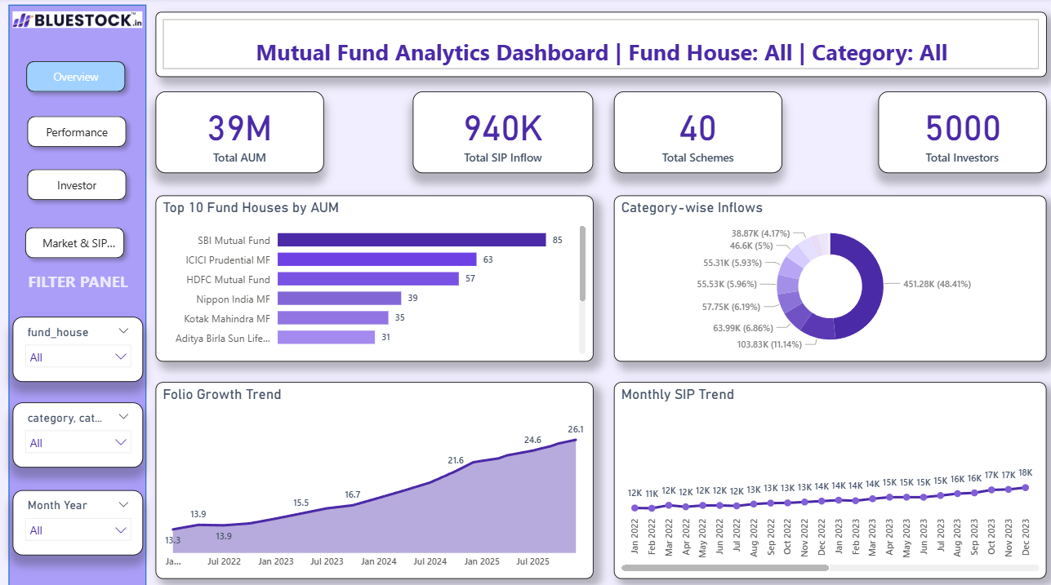
Overview Dashboard
Dashboard Highlights
Top 10 Fund Houses ranked by Assets Under Management (AUM).
Category-wise SIP inflow distribution using a donut chart.
Folio Growth Trend showing growth over time.
Monthly SIP Trend to monitor investment patterns.
Interactive slicers for Fund House, Category, and Month-Year filtering.
Dynamic dashboard title that updates based on user selections.
Objective
The Overview Dashboard provides a consolidated view of the mutual fund ecosystem by displaying key performance indicators, fund house rankings, category-wise inflows, and SIP growth trends. It enables users to monitor overall market performance through an interactive interface.
Business Insights
SBI Mutual Fund has the highest AUM among all fund houses.
Equity-oriented categories contribute the largest share of inflows.
Monthly SIP contributions show a consistent upward trend.
Folio count has grown steadily, indicating increasing investor participation.
Key Performance Indicators (KPIs)
Total AUM: ₹39 Million
Total SIP Inflow: 940K
Total Mutual Fund Schemes: 40
Total Investors: 5,000

Slide 6
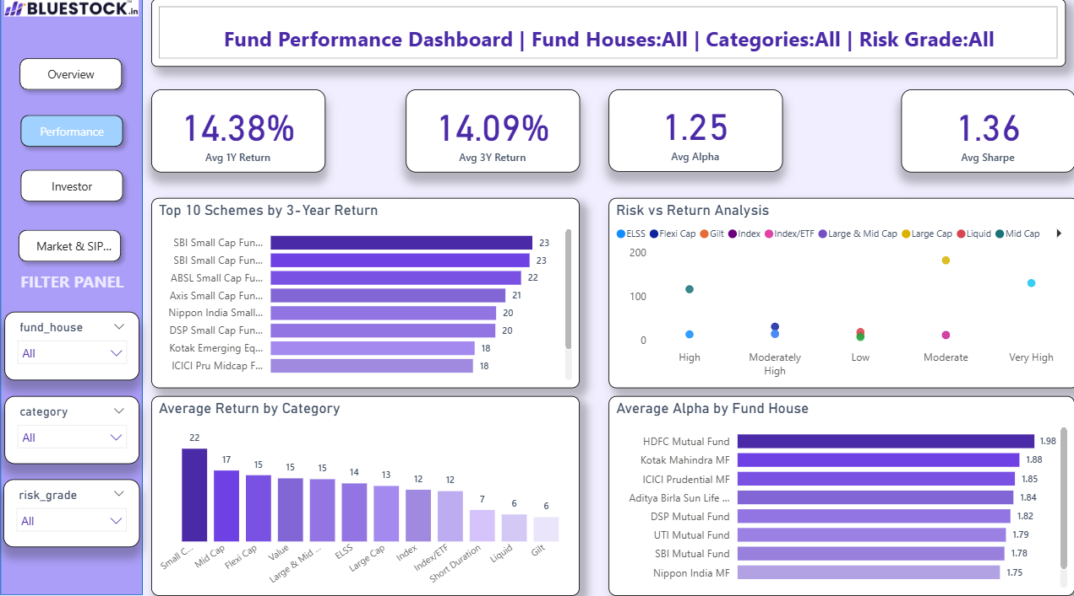
Fund Performance Dashboard
Key Performance Indicators (KPIs)
Average 1-Year Return
Average 3-Year Return
Average Alpha
Average Sharpe Ratio
Dashboard Highlights
Top 10 Schemes by 3-Year Return
Risk vs Return Analysis
Average Return by Category
Average Alpha by Fund House
Interactive slicers for Fund House, Category, and Risk Grade
Dynamic title based on selected filters
Objective
The Fund Performance Dashboard evaluates the performance of mutual funds by analyzing key financial metrics such as returns, Alpha, Sharpe Ratio, and risk levels. It enables users to compare fund houses and investment categories for better investment decisions.
Buisness Insights
Identifies top-performing mutual fund schemes.
Compares returns across different investment categories.
Evaluates the relationship between risk and return.
Helps investors choose funds based on performance and risk profile.

Slide 7
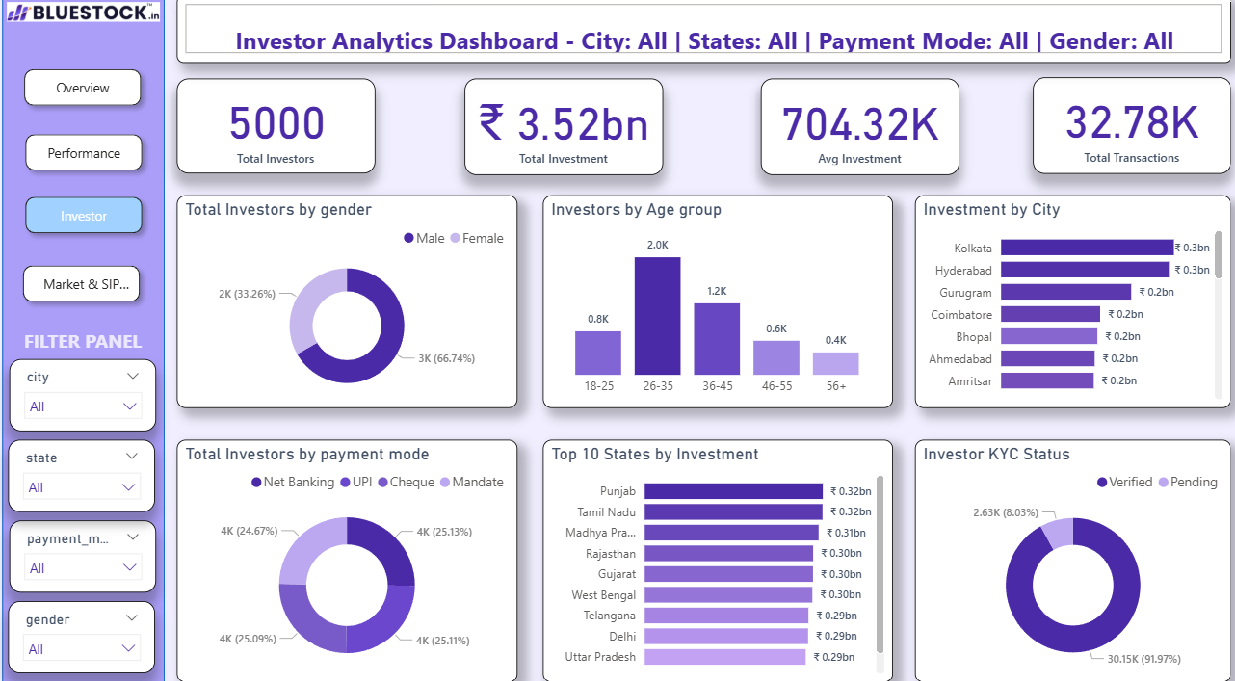
Investor Analytics Dashboard
Dashboard Highlights
Gender-wise Investor Distribution
Investors by Age Group
Investment by City
Investment by State
Payment Mode Analysis
Investor KYC Status
Interactive slicers for City, State, Payment Mode, and Gender
Dynamic dashboard title based on selected filters
Business Insights
Male investors account for approximately 67% of the investor base.
The 26–35 age group contributes the highest number of investors.
Punjab records the highest total investment among states.
Kolkata and Hyderabad are among the leading cities by investment value.
Most investors have Verified KYC, indicating strong regulatory compliance.
Investments are distributed fairly evenly across different payment modes.
Objective
The Investor Analytics Dashboard provides insights into investor demographics, investment behavior, transaction patterns, and KYC status. It helps understand how different investor segments contribute to overall investments.
Key Performance Indicators (KPIs)
Total Investors: 5,000
Total Investment: ₹3.52 Billion
Average Investment: ₹704.32K
Total Transactions: 32.78K

Slide 8
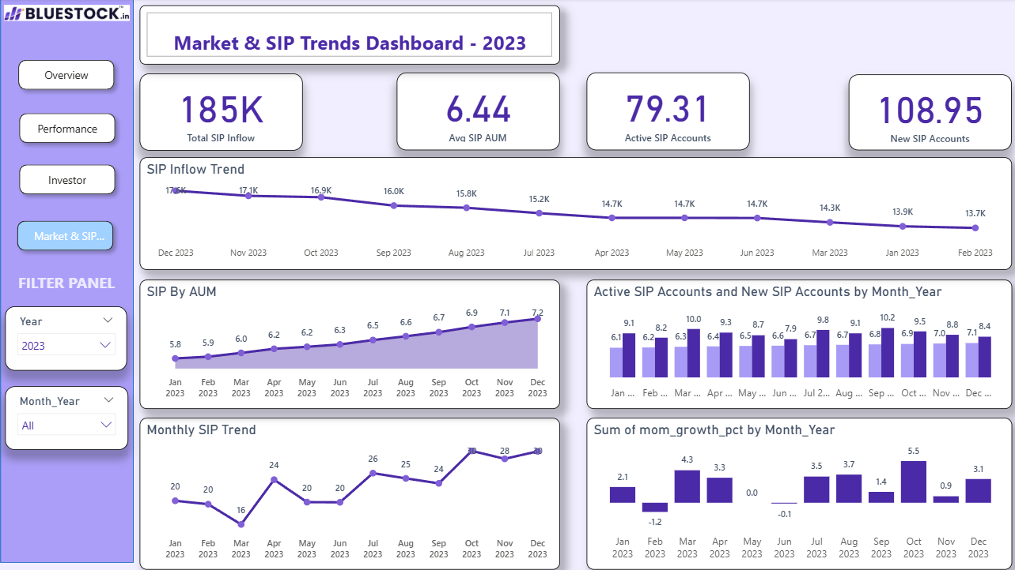
Market & SIP Trends Dashboard
Dashboard Highlights
SIP Inflow Trend by Month
SIP AUM Growth Trend
Active vs New SIP Accounts
Monthly SIP Trend
Month-on-Month Growth Percentage
Interactive slicers for Year and Month-Year
Dynamic dashboard title based on selected filters
Business Insights
SIP AUM shows a steady upward trend throughout the year.
Active SIP accounts remain consistently high, indicating sustained investor participation.
New SIP account registrations fluctuate monthly, reflecting changing market activity.
Month-on-month growth highlights periods of positive and negative market momentum.
Time-based analysis helps identify seasonal investment patterns and overall SIP growth.
Objective
The Market & SIP Trends Dashboard analyzes SIP performance over time by tracking inflows, assets under management, account growth, and month-on-month market trends. It helps identify investment patterns and overall market movement.
Key Performance Indicators (KPIs)
Total SIP Inflow: 185K
Average SIP AUM: 6.44
Active SIP Accounts: 79.31
New SIP Accounts: 108.95

Slide 9
Key Business Insights
Recommendations
Increase awareness campaigns targeting younger investors (18–25 years).
Promote high-performing fund categories to potential investors.
Expand marketing efforts in states and cities with lower investment participation.
Encourage digital payment methods to simplify investment transactions.
Continue improving KYC verification processes for a smoother onboarding experience.
Fund Performance
SBI Mutual Fund recorded the highest Assets Under Management (AUM).
Flexi Cap and Large & Mid Cap categories demonstrated strong investment performance.
Higher risk funds generally delivered better long-term returns.
Investor Analytics
Total investor base reached 5,000.
The 26–35 age group contributed the largest share of investors.
Male investors accounted for nearly 67% of the investor population.
Punjab and major metropolitan cities contributed significantly to total investments.
Most investors had Verified KYC, ensuring strong compliance.
SIP & Market Trends
SIP inflows remained stable throughout the year.
SIP AUM showed continuous growth, indicating increasing investor confidence.
Active SIP accounts consistently exceeded new SIP registrations.
Monthly growth analysis revealed periods of both positive and negative market momentum.

Slide 10
Conclusion & Future Scope
Conclusion
Successfully developed an end-to-end Mutual Fund Analytics solution using Python, PostgreSQL, and Power BI.
Cleaned and transformed raw datasets to ensure accurate and reliable analysis.
Built four interactive dashboards to analyze fund performance, investor behavior, and SIP trends.
Created dynamic KPIs, DAX measures, and interactive filters for an enhanced user experience.
The dashboard enables stakeholders to monitor investment trends and make informed, data-driven decisions.
Future Scope
Integrate live mutual fund data using APIs for real-time analytics.
Add predictive models to forecast SIP growth and fund performance.
Incorporate advanced financial metrics such as CAGR, XIRR, and rolling returns.
Publish the dashboard on Power BI Service with scheduled data refresh.
Implement role-based access control and row-level security for enterprise deployment.

Slide 11
Thank You
Mutual Fund Analytics Dashboard
Swapnil Singh
📧 Email: your.email@example.com
🔗 LinkedIn: https://www.linkedin.com/in/swapnil-singh-251601311/💻 GitHub: https://github.com/swap-09singh

